Slide 1

Logic Synthesis With Design Compiler
Advisor : Yu-Cheng Fan
Reporter :Min-Hua Lu

Slide 2
OUTLINE
Introduction
Synthesis Object
Synthesis GUI-Design Vision
Setting Design Constraints
Setting Design Environment
Reports and Save file

Slide 3
INTRODUCTION

Slide 4





What is Logic Synthesis? We Say a Lego Story.
We Use Lego to Build a Dream in Our Childhood

Slide 5
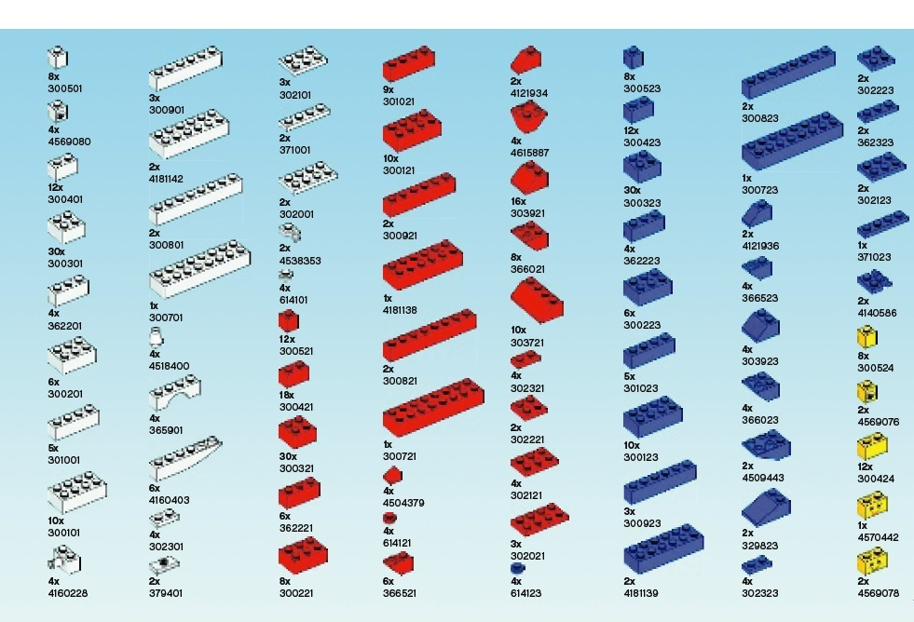
How to Build a Dream? Based on Cells……

Slide 6
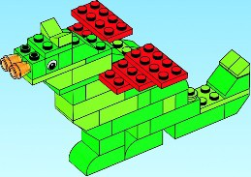
Step 1 ：Function Description
System Spec.
Algorithm
RTL Code

Slide 7










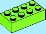








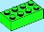























Step 2 ：Blocks Analysis (Design Compiler and Cell Library Design)
1x
1x
1x
1x
2x
2x
2x
2x
1x
2x
1x
1x
1x
1x
1x
1x
1x
1x
1x
1x
1x
1x
1x
2x
1x
2x
1x
2x
1x
1x
2x
2x
1x
1x
1x
2x
1x
1x
1x
1x
1x
1x
1x
1x

Slide 8
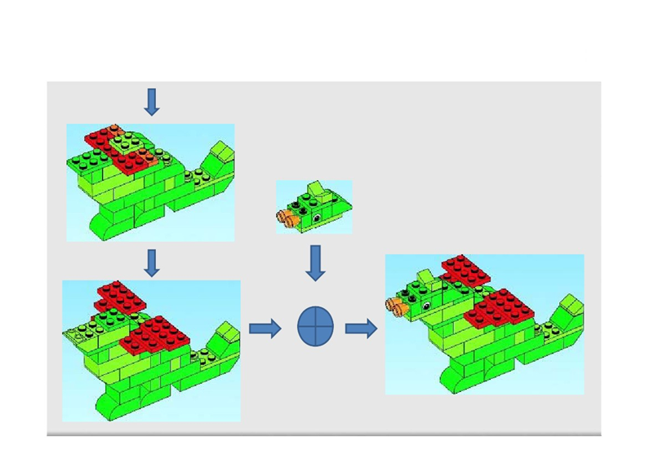
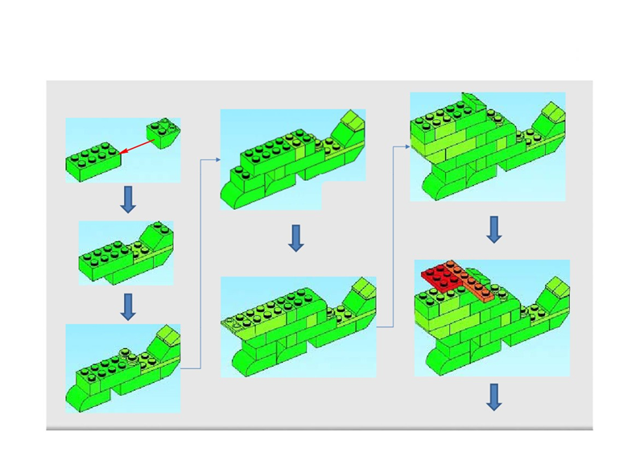
Step 3 ：Logic Synthesis and Optimization

Slide 9
How to Build a Circuit Dream ? We Adopt the Cell-Based Design flow
System Spec.
Algorithm
RTL Code
APR
DFT
Logic Synthesis
Cell Library

Slide 10
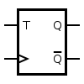
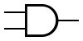
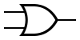
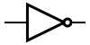
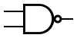
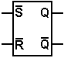
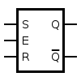
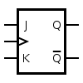
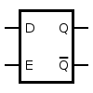
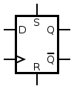

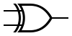

Cell Library (Logic Gate v.s. Lego)

Slide 11
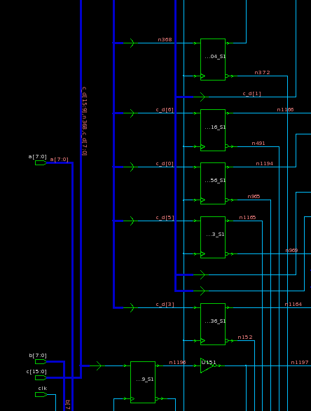
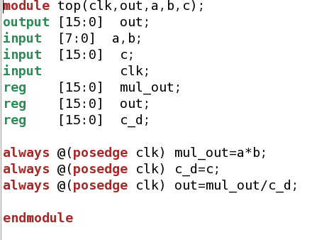
Logic Synthesis
Behavior code
Gate level code

Slide 12
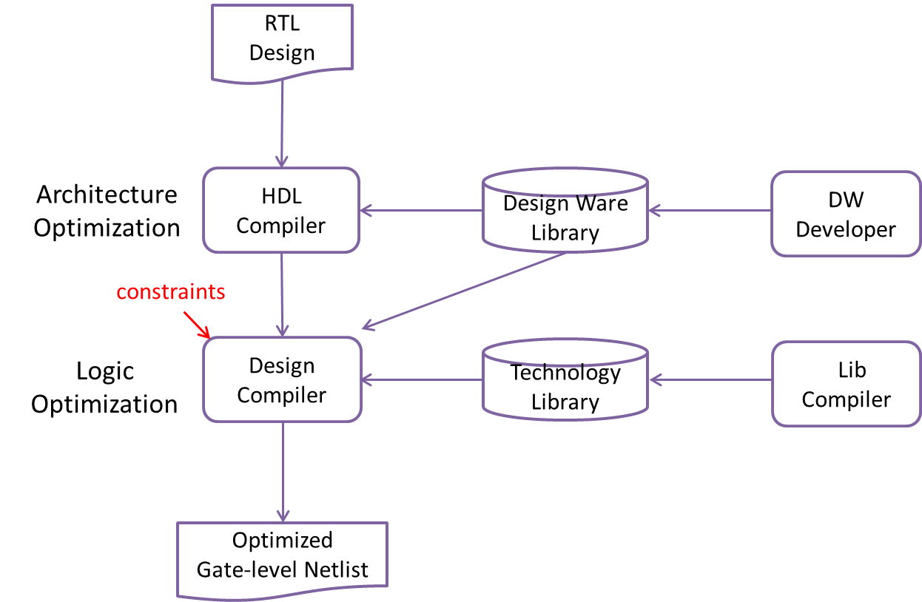
Logic Synthesis Overview

Slide 13
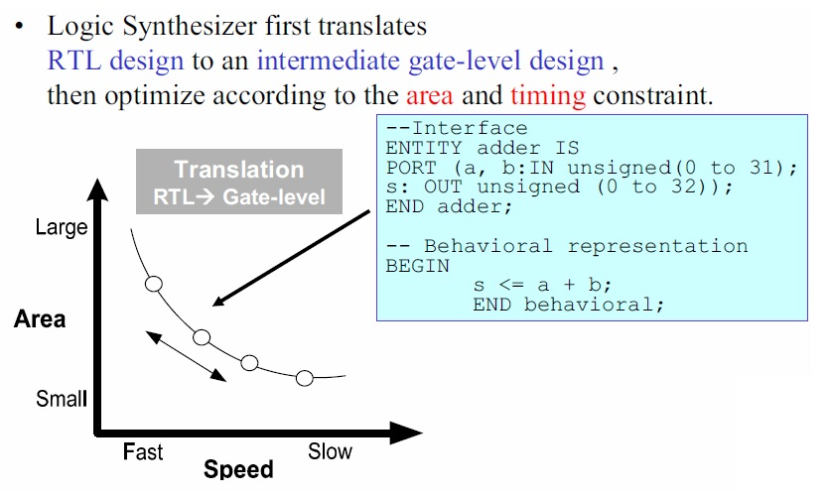
Synthesis is Constraint Driven

Slide 14
SYNTHESIS OBJECT

Slide 15
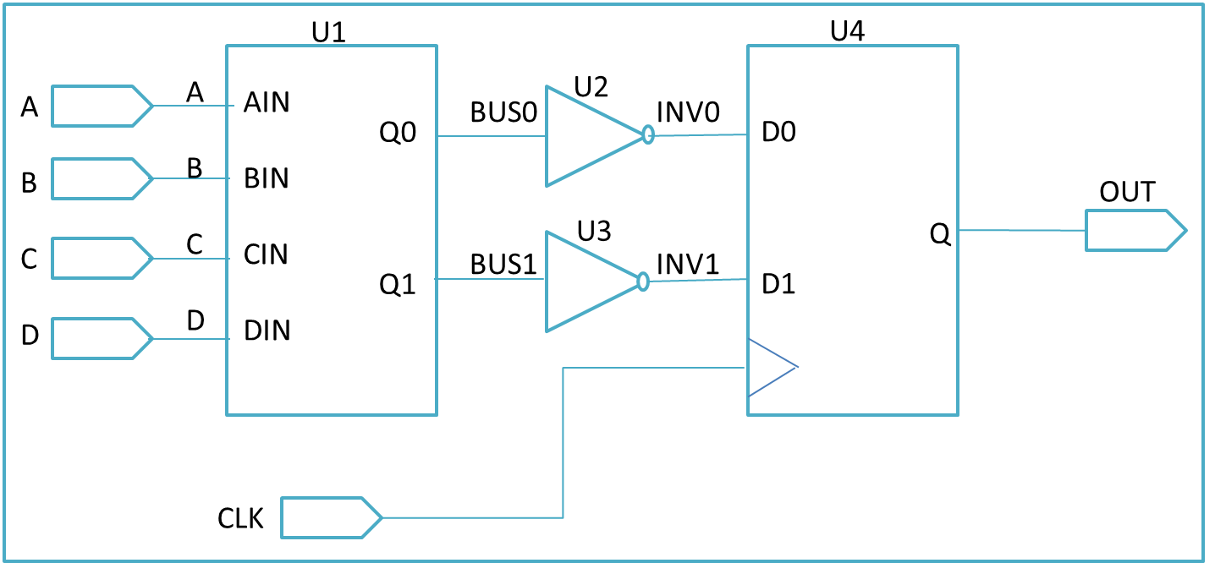
Design Objects (1/2)
design
cell
[get_cell U1]
net
[get_nets BUS0]
port
[get_port B]
clock
pin

Slide 16
Design Objects (2/2)
Design ：A circuit that performs one or more logical functions.
Cell：An instantiation of a design within another design.
Port：The input or output of a design.
Net ：The wire that connects ports to pints and/or pints to other each other.
Clock ：Waveform applied to a port or pin identified as a clock source.

Slide 17
SYNTHESIS GUI-DESIGN VISION

Slide 18
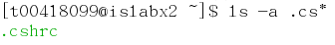
Environment Setup (1/3)
Set the environmental files
Open Terminal
Key in Key in “ ls –a .cs* ”
“cp/home/standard/Environment_Setup_File/cshrc .cshrc”
Key in “ source .cshrc”
Dr. Yu-Cheng Fan National Taipei University of Technology Taipei, Taiwan

Slide 19
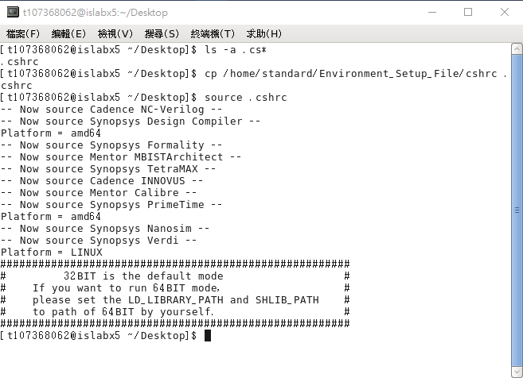
Environment Setup (2/3)
ls –a .cs* (*後面有空格)
cp /home/standard/Environment_Setup_File/cshrc .cshrc
^ 空格 ^ 空格
source .cshrc
^ 空格
代表終端機(Terminal)，成功開啟
20

Slide 20
Environment Setup (3/3)
Create a New Folder for Synthesis
Ex:
mkdir Synthesis (terminal command)
cd Synthesis (terminal command)
Copy File for Environment Setting
cp /home/standard/Environment_Setup_File/synthesis_setup_for_18/synopsys_dc.setup .synopsys_dc.setup
Copy File for Synthesis
cp /home/standard/summer2021/synthesis/* .
代表空格

Slide 21
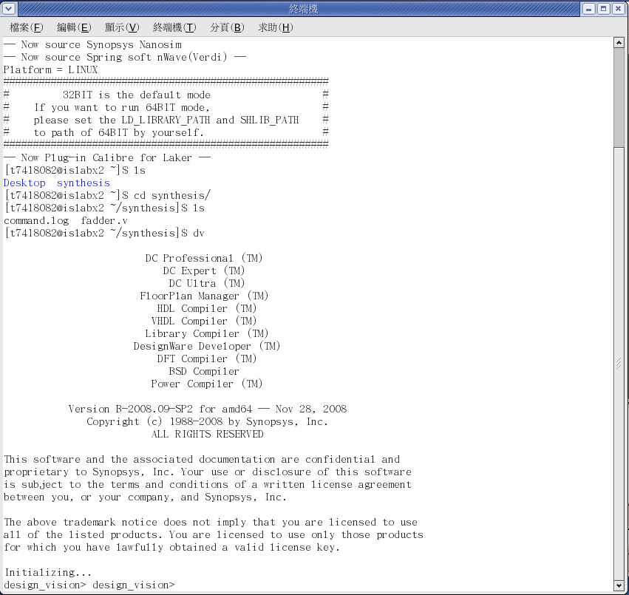
Open Design Vision
Please key in dv

Slide 22
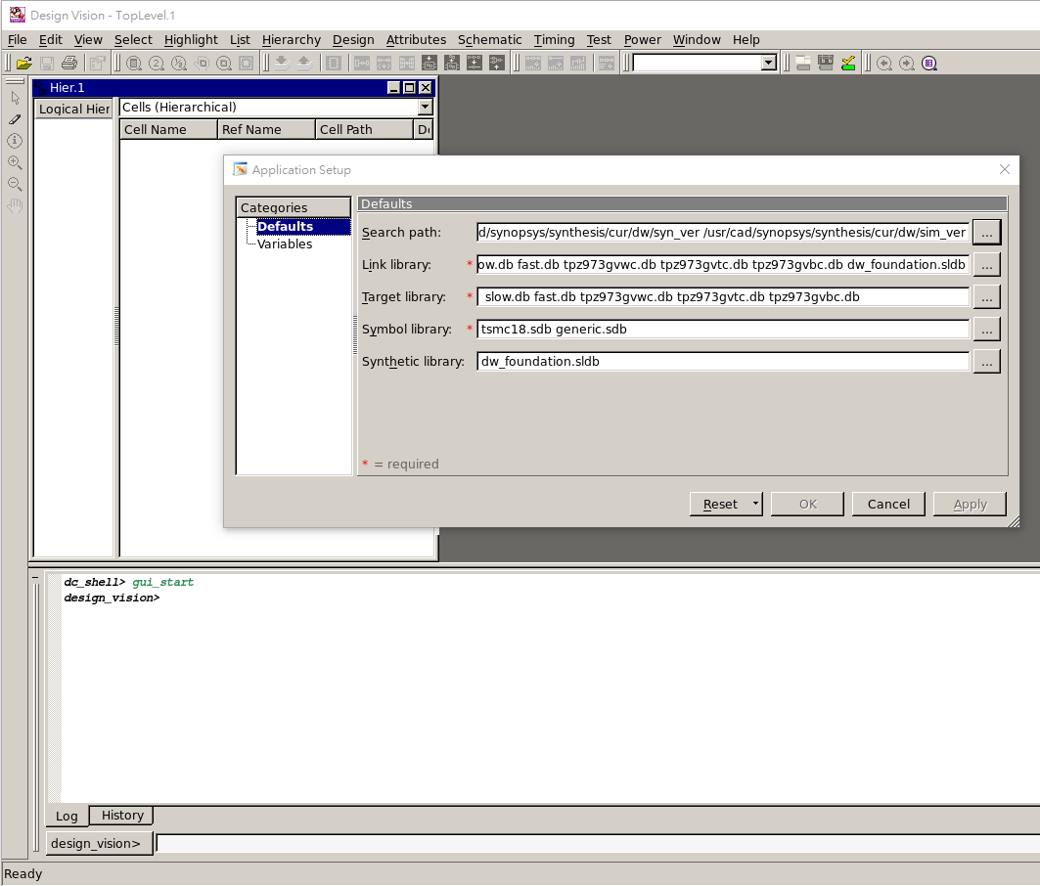
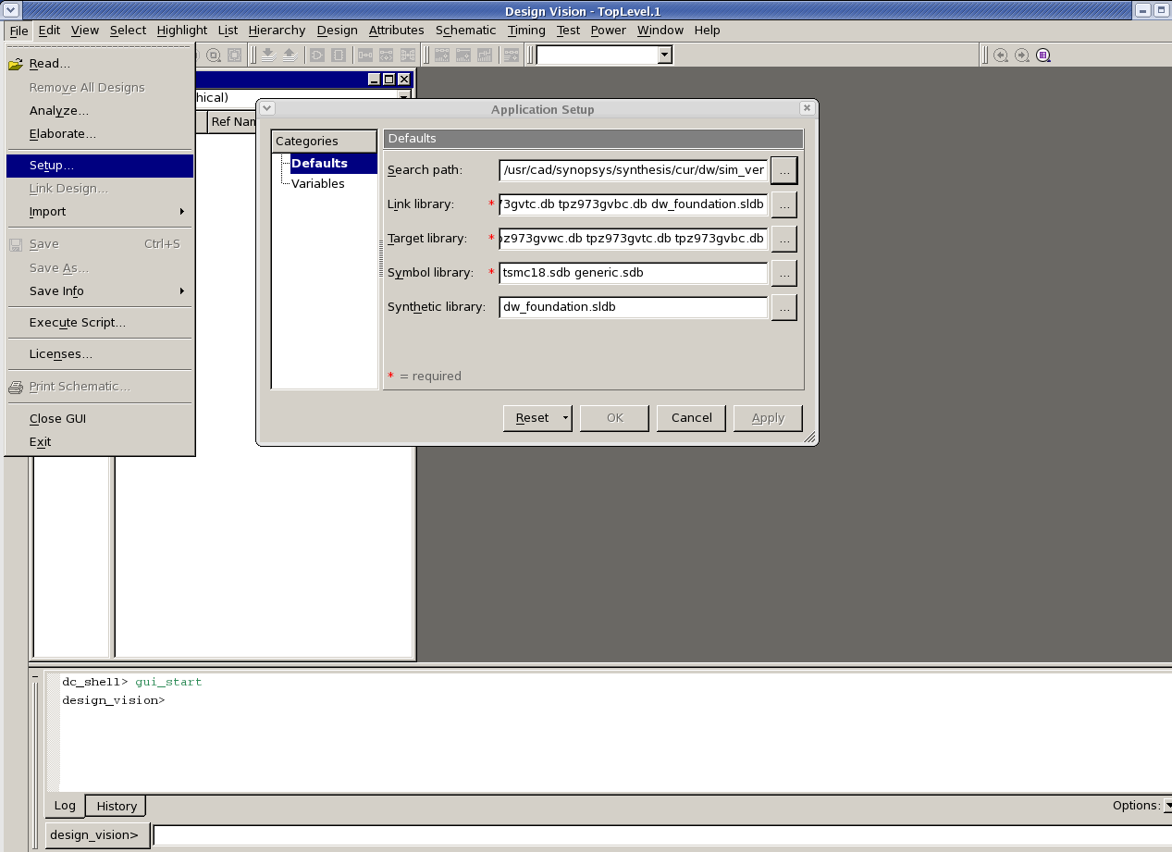
Environment Setup Check
打開環境設定視窗確認是否成功設定

Slide 23
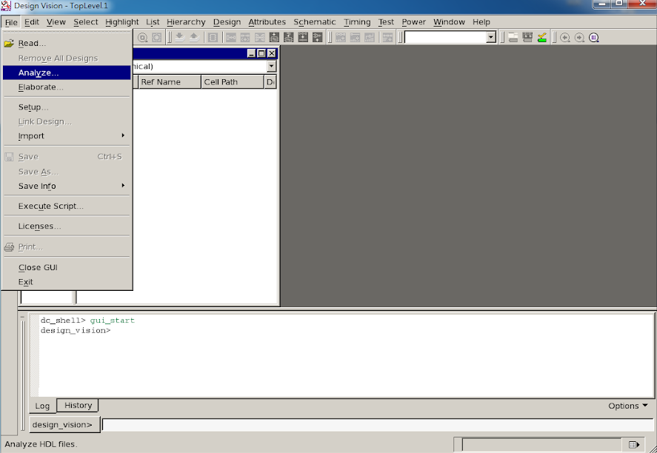
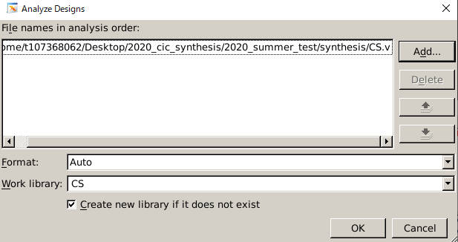
Analysis the Design(1/2)
1
2
3
3
Add your design
Choose CS.v
4
4
Select work lib

Slide 24
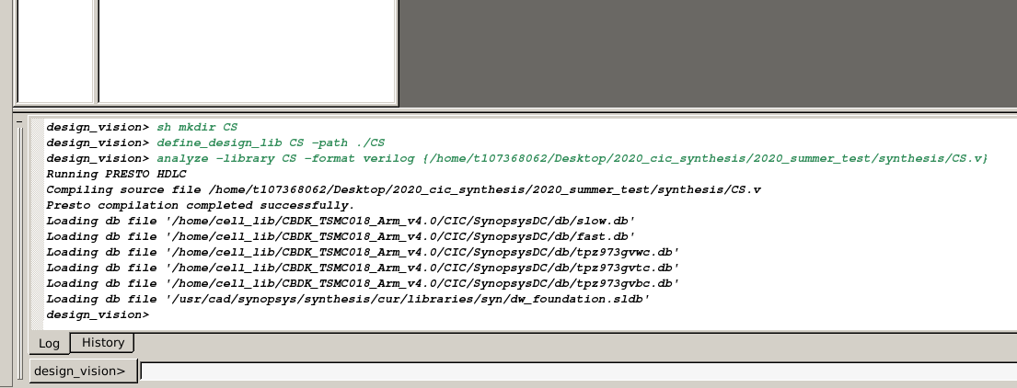
Analysis the Design(2/2)

Slide 25
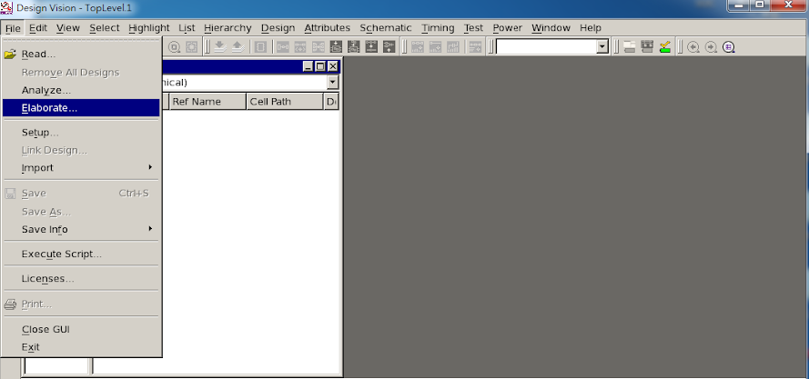
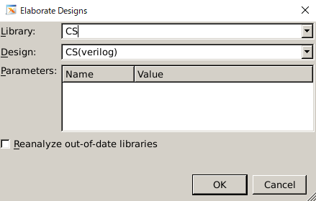
Elaborate the Design
1
2
3
Select work lib
4
Select your design

Slide 26
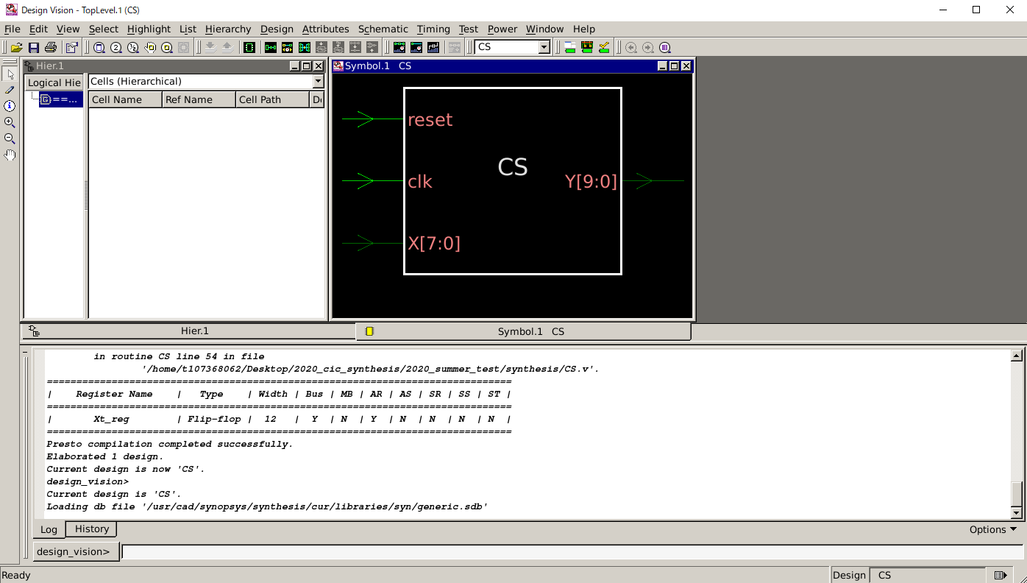
Symbol View
2
Create Symbol View
1
Select model or cell
Symbol View

Slide 27
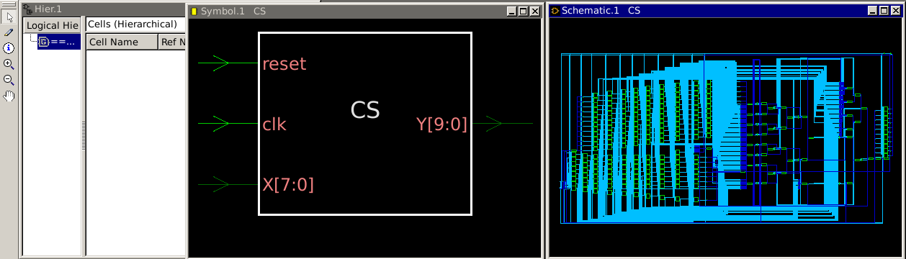
Schematic View
Symbol View
Click twice
Schematic View

Slide 28
SETTING DESIGN CONSTRAINTS

Slide 29
Define Clock specification
We need to accurately specify the clock including the clock routing details in the early design stage in order to achieve timing convergence.
What should be defined?
Period
Waveform
Uncertainty
skew
Latency
Source latency
Network latency
Transition
Input transition
Clock transition
Area
Max fanout

Slide 30
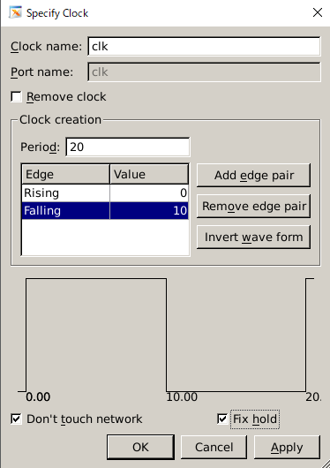
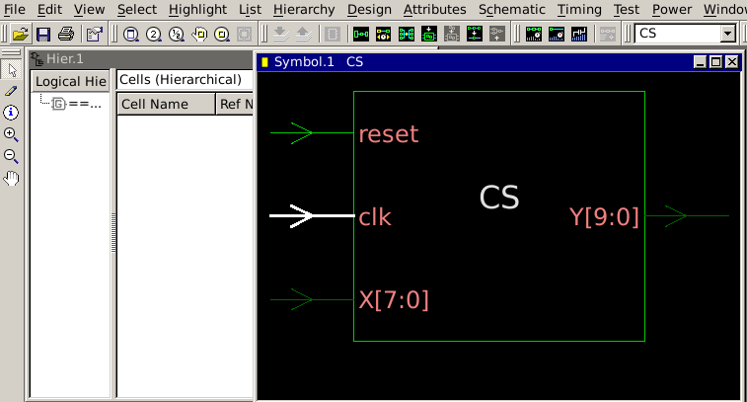
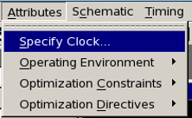
Specify Clock
Command: create_clock ‐name clk ‐period 20 ‐waveform {0 10} [get_ports clk]
set_dont_touch_network [get clocks clk]
set_fix_hold [get_clocks clk]
3
Enter clk name
4
Enter period
2
5
Enter waveform
1
Select clock port
6

Slide 31
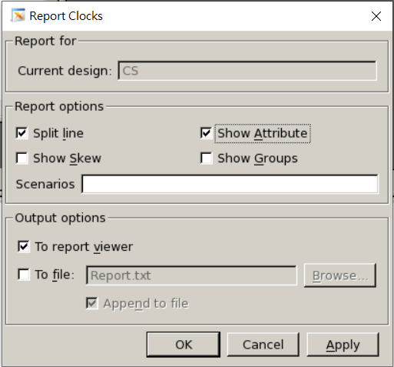
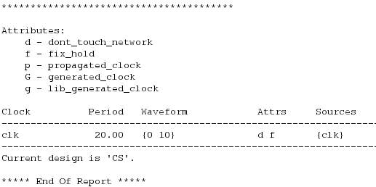
Report Clock
Design → Report Clocks

Slide 32
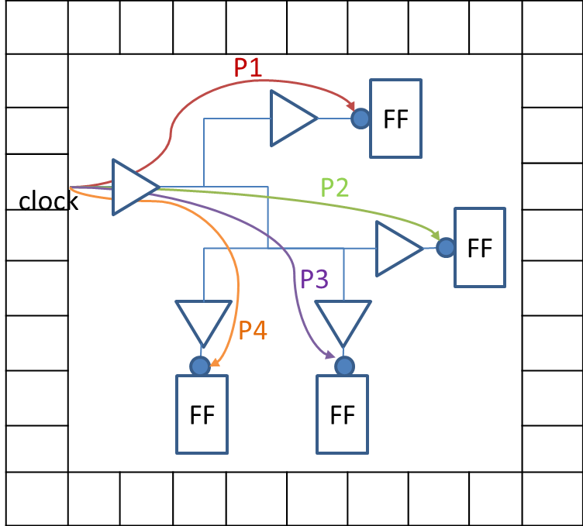
Clock skew
The maximum difference between the arrival of clock signals at sequential cells in one clock domain or between domains.
Command: set_clock_uncertainty 0.8 [get_clocks clk]
Arrival(P1)=0.5ns
Arrival(P2)=1ns
Arrival(P3)=1.2ns
Arrival(P4)=1.3ns
Uncertainty = 1.3 – 0.5
= 0.8ns clock skew!!

Slide 33
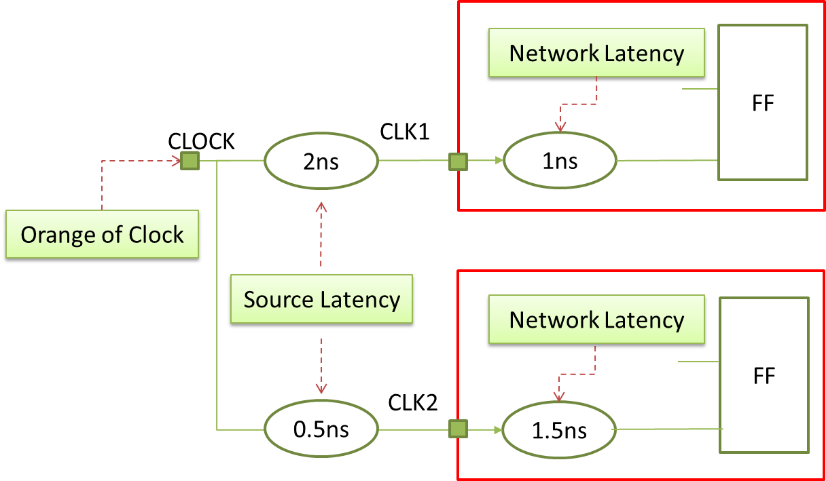
Model Source Latency
Source latency is the propagation time from the actual clock origin to the clock definition point in the design.
Command:
set_clock_latency -source 2 [get_clocks CLK1]
set_clock_latency -source 0.5 [get_clocks CLK2]
set_clock_latency 1 [get_clocks CLK1]
set_clock_latency 1.5 [get_clocks CLK2]

Slide 34
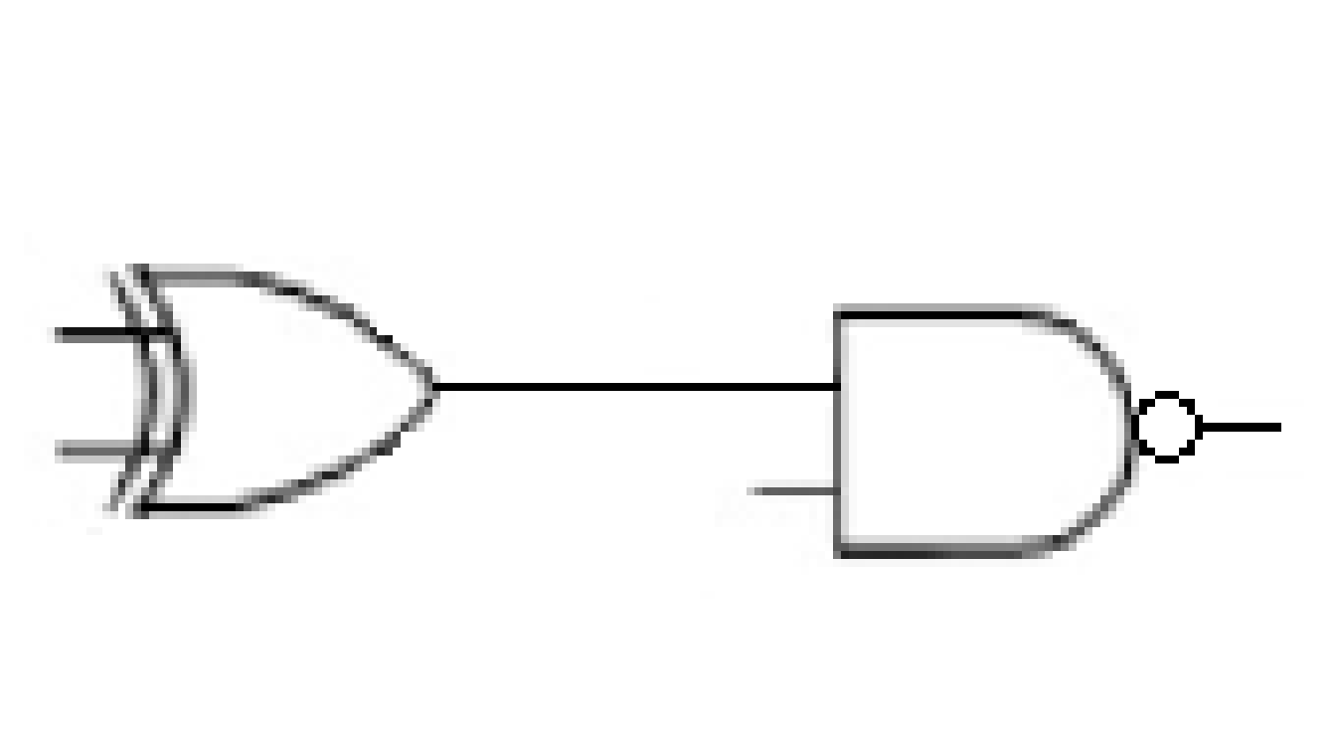
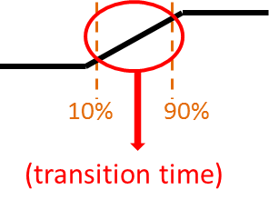
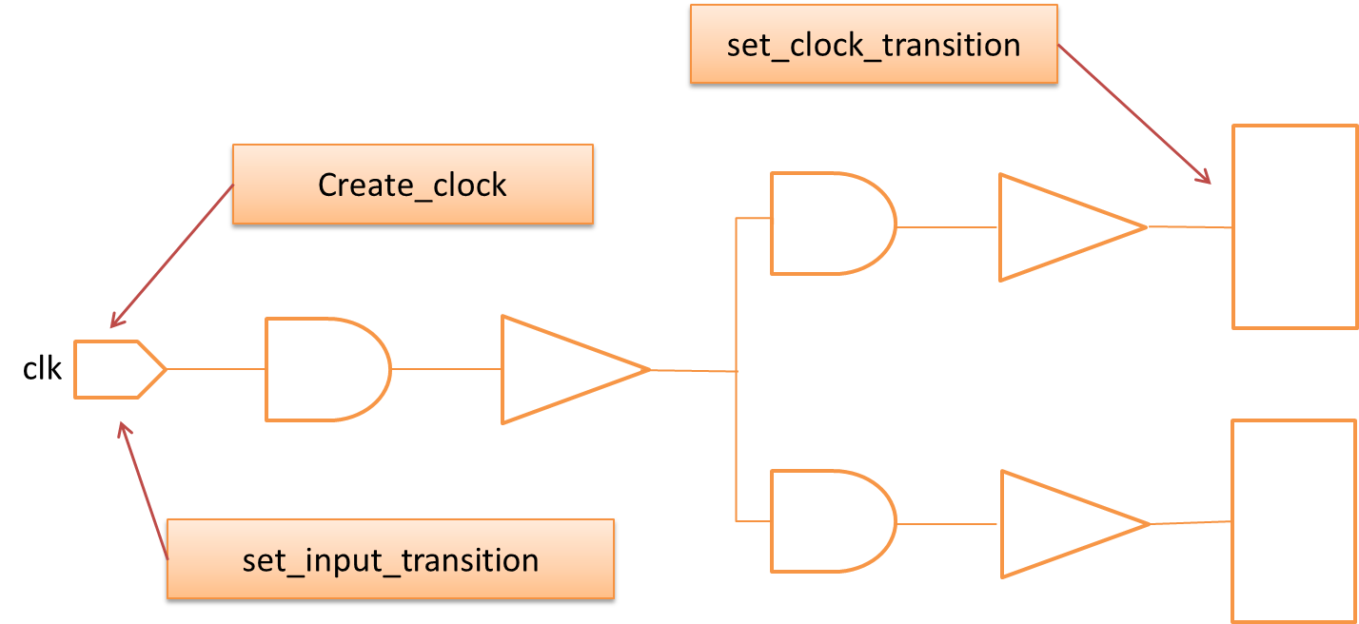
Clock Transition Time
Command: set_input_transition 0.5 [get_clocks clk]
set_clock_transition 0.5 [get_clocks clk]

Slide 35
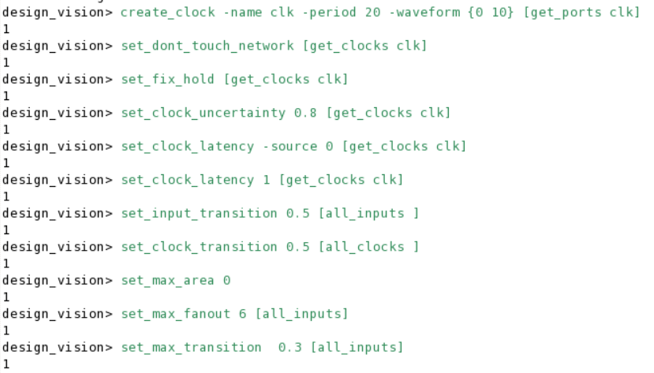
Reference command
Command:
create_clock -name clk -period 20 -waveform {0 10} [get_ports clk]
set_dont_touch_network [get_clocks clk]
set_fix_hold [get_clocks clk]
set_clock_uncertainty 0.8 [get_clocks clk]
set_clock_latency -source 0 [get_clocks clk]
set_clock_latency 1 [get_clocks clk]
set_input_transition 0.5 [all_inputs]
set_clock_transition 0.5 [all_clocks]
set_max_area 0
set_max_fanout 6 [all_inputs]
set_max_transition 0.3 [all_inputs]
34

Slide 36
SETTING DESIGN ENVIRONMENT

Slide 37
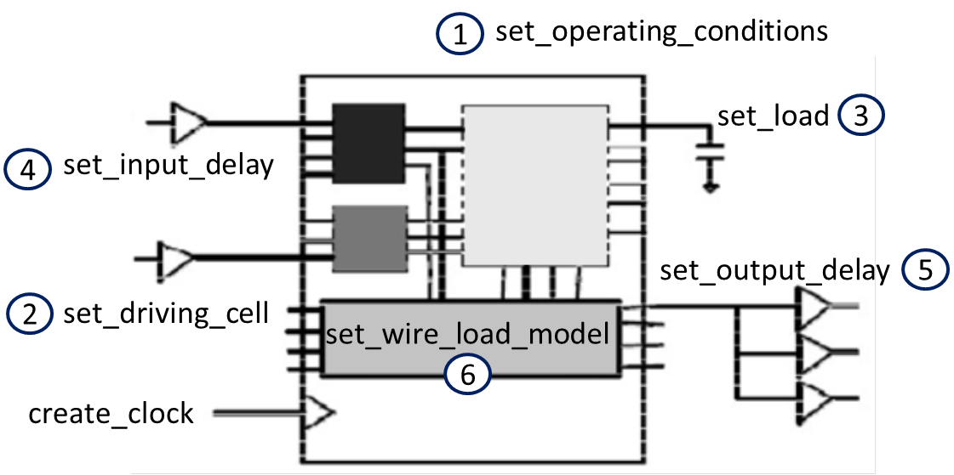
Real World Environment
Beware the defaults are not realistic conditions
Input drive is not infinite
Capacitive loading is usually not zero
Consider process, voltage, temperature (PVT) variation

Slide 38
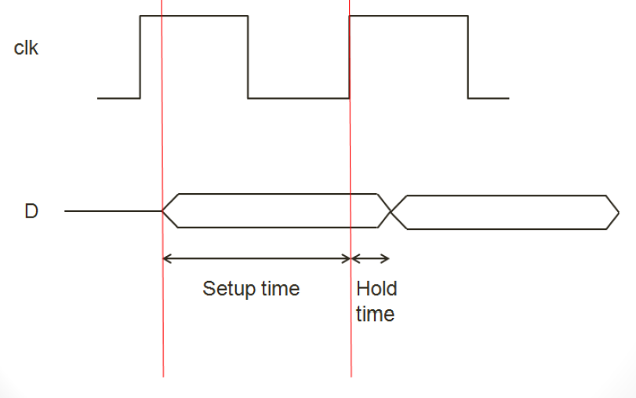
Setup Time & Hold Time
37

Slide 39
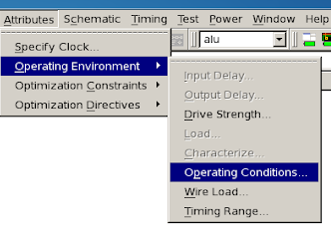
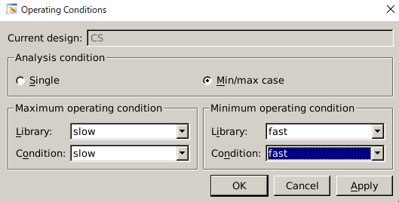
Setting Operating Condition
Command: set_operating_conditions -min_library fast -min fast -max_library slow -max slow
1
3
2
4

Slide 40
Setting driving Cell and output load
1.Setting input driving strength for clk port
-> set_driving_cell -library slow -lib_cell BUFX4 -pin {Y}
[get_ports clk]
2.Setting input driving strength for all input port except clk
-> set_driving_cell -library slow -lib_cell DFFX1 -pin {Q}
[remove_from_collection [all_inputs] [get_ports clk]]
3.Setting output load 0.001913
-> set_load 0.001913 [all_outputs]

Slide 41
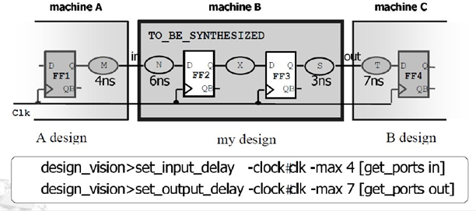
Input Delay and Output Delay
Clock cycle > = (DFF clk ‐ Q delay) + X + DFF setup
Input Delay = (DFF clk ‐ Q delay) + M
Output delay = T + DFF setup

Slide 42



Setting Input Delay
set_input_delay -clock clk -max 1 [remove_from_collection [all_inputs] [get_clocks clk]]
set_input_delay -clock clk -min 0.2 [remove_from_collection [all_inputs] [get_clocks clk]]
2
1
3
4

Slide 43



Setting Output Delay
Command: set_output_delay -clock clk -max 1 [all_outputs]
set_output_delay -clock clk -min 0.1 [all_outputs]
2
1
3
4

Slide 44



Setting Wire Load Model for Net Delay
Command: set_wire_load_model -name tsmc18_wl10 -library slow
2
1
3

Slide 45
Check & uniquify Design
You have to check design after setting.
Command:
->check_design -multiple_designs
->uniquify

Slide 46
REPORTS AND SAVE FILE

Slide 47




Reports Before Compiler
Make sure the output loading is 0.001913
in Report Ports.

Slide 48


Compile Design

Slide 49

Mapping Effort
Three effort levels, low, medium, high, determine relative amount of CPU time spent during mapping phase of compile.
Low - quicker synthesis, does not do all algorithms.
Medium – default, good,
for many design.
High – it does critical path
re-synthesis, but it will use
more CPU time; in some
cases the action of compile
will not terminate.

Slide 50

Explore The Schematic View
Click twice
Select CS and save again

Slide 51



Report Area & Timing
Design ‐> Report Area
Timing ‐> Report Timing Path

Slide 52

Report Area & Timing
Area report shows the um² of the design.
Command: report_area
Reports Area (μm2) : Total Area
Gate Count Gate Count: Total cell area / 10

Slide 53


Save Design as .DDC File

Slide 54
Write SDF File for Pre‐Sim
The file includes information of delay of Gate‐Level circuit.
Command:
-> write_sdf ‐version 1.0 ‐context verilog chip_syn.sdf
-> write_sdc ‐version 1.7 CHIP.sdc

Slide 55


Save Design as .V File : Netlist

Slide 56

Pre‐Layout Simulation
以剛剛產生出的Netlist檔進行 Gate‐Level Simulation也常稱作Pre‐Sim用以驗證確認我們合成出來的邏輯電路是否符合System Spec.所要求的功能。
Command (Terminal , not Design Compiler):
ncverilog testfixture.v CS_compile.v tsmc18.v +access+r

Slide 57
FIR.V

Slide 58

Reports Before Compiler
Make sure the output loading is 0.001913
in Report Ports.

Slide 59


Report Area & Timing
Design ‐> Report Area
Timing ‐> Report Timing Path
Reports Area (μm2) : Total Area
Gate Count Gate Count: Total cell area / 10

Slide 60

Pre‐Layout Simulation
以剛剛產生出的Netlist檔進行 Gate‐Level Simulation也常稱作Pre‐Sim用以驗證確認我們合成出來的邏輯電路是否符合System Spec.所要求的功能。
Command (Terminal , not Design Compiler):
ncverilog FIR_test.v FIR_compile.v –v tsmc18.v +access+r +define+SDF

Slide 61


